Slide 1
Stock trading strategy based on Neural networks
ZHAN Hui

Slide 2
content
Purpose
System structure
Convert to tradable strategies
Initial NN
Improvement
Future

Slide 3
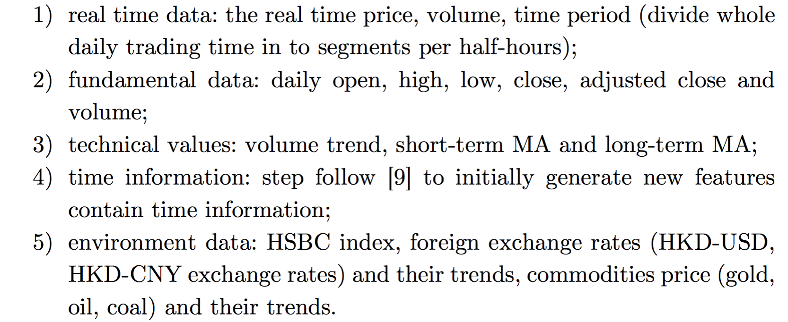
1. Purpose
Learn from historical trading information to recommend trading strategies for a specific market situation:
Input:
Meanwhile training out well performance NN and using it to predict price trend.

Slide 4
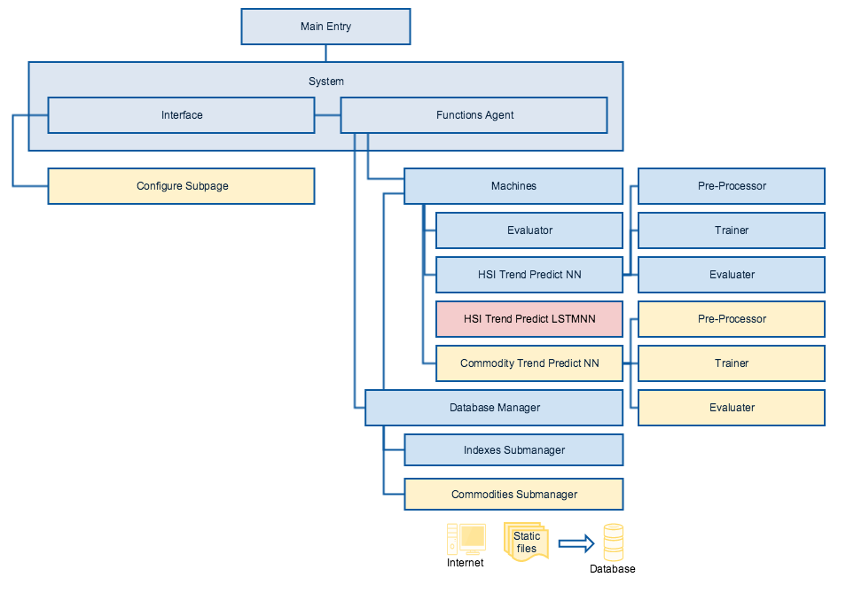
2. System structure
degree red : develop now;
degree yellow : planned to develop next step;
degree blue : developed.

Slide 5
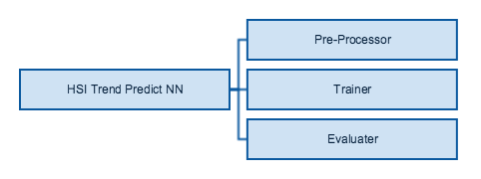
3. Convert to tradable strategies
Separate the part of well performance to do trend predict.

Slide 6
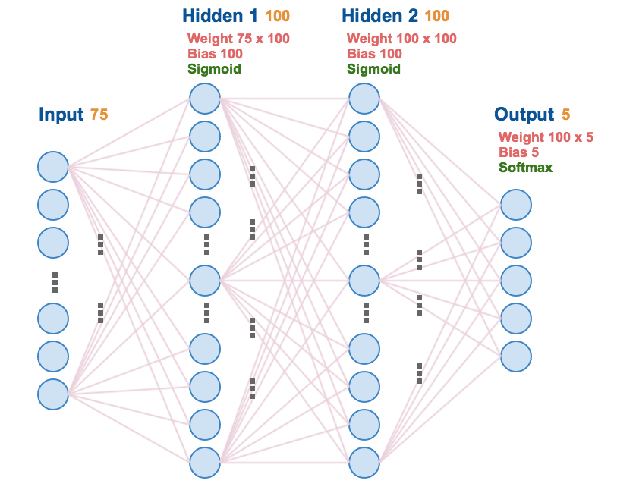
4. Initial NN
HSI daily trend predict NN.
Structure:

Slide 7
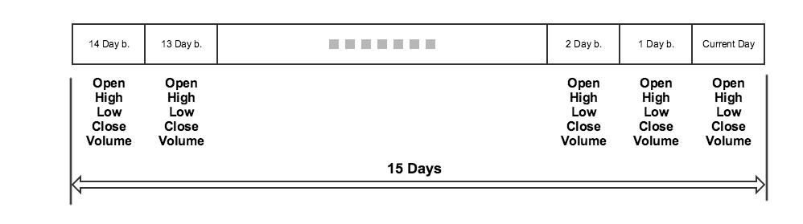
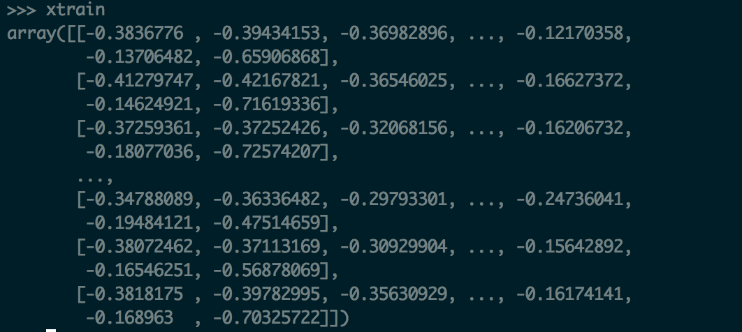
4. Initial NN
Input:
15 days’ OHLCV data (1 year).
Preprocess the data, making of data in the range of [-1,1].

Slide 8
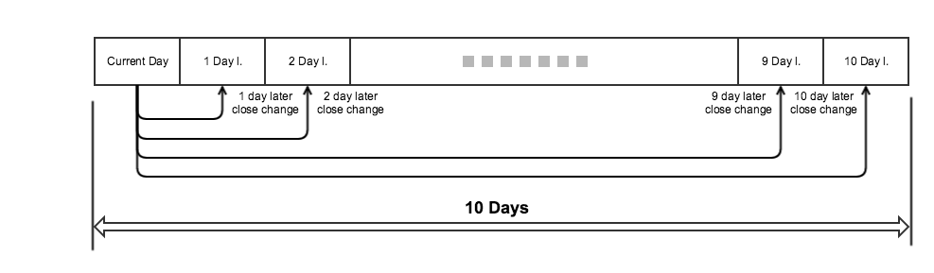
4. Initial NN
Output(labels):
10 days’ close price change rate.
Preprocess the data, dividing the change rate into 5 classes, namely DU-dramatic up, U-up, F-fluctuate, D-down and DD-dramatic down.
E.g. [1,0,0,0,0] means DU; [0,0,1,0,0] means F.

Slide 9
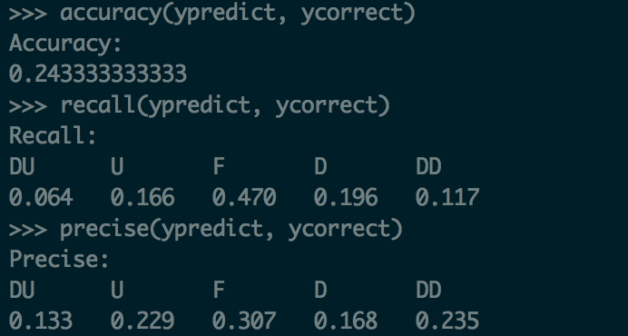
4. Initial NN
Result:
Use accuracy, recall and precise to evaluate the NN.
That means the current NN performs bad.

Slide 10
5. improvement
Improvement:
Try to use longer training data (e.g. 3 years); shorter training data (e.g. 5 months);
Try to use different label mechanism (e.g. 2/3 classes);
Try to use different Input data (e.g. remove OHL price and rest close price and volume only);
Try to add some new features (e.g. SMA indicators);
Try add more hidden layers/neurons.
Most Interested:
Try another NN, current NN is a simple forward propagation NN, try implement RNN and CNN.

Slide 11
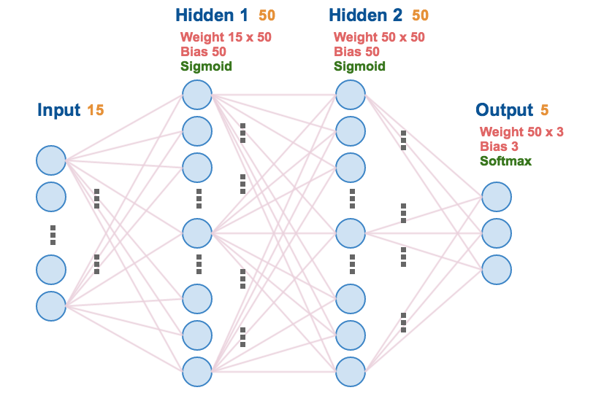
5. improvement
New structure
Cut down hidden neurons
Cut down inputs
Use less classes
It is an overall smaller size NN

Slide 12
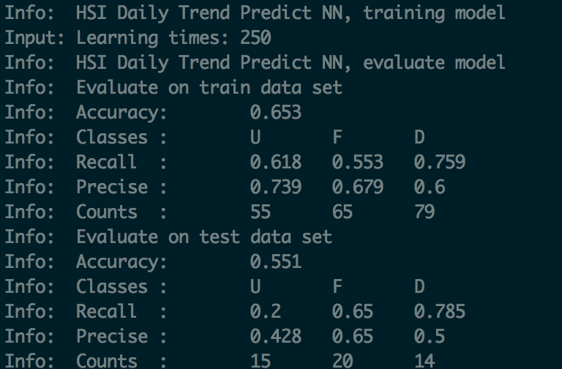
5. improvement
New result

Slide 13
5. improvement
New result

Slide 14
6. FUTURE
RNN
Online learning machine

Slide 15
The end Thanks

